Slide 1
FaceNet Implementation and Evalutation in Python
Presented by: Ibrahim Ahmed
Department of Computer Science, Michigan State University

Slide 2
Outline
Overview of FaceNet
Implementation
Results
Notes:
The “real world” is a complex environment. Autonomous robots that intend to operate in the “real world” need to be prepared for the dynamic factors and reactivity of the “real world” and its large environment.

Slide 3
Overview – What is FaceNet?
FaceNet is a neural network that is optimized for facial recognition, developed by employees at Google in 2015
Notes:
In this paper, the analysis of testability is constrained to Level 4 of the NHTSA.

Slide 4
Overview – Siamese Network
Click here for source
Notes:
Siamese networks are a special type of neural network architecture. Instead of a model learning to classify its inputs, the neural networks learns to differentiate between two inputs. It learns the similarity between them.
FaceNet is a type of Siamese network
Siamese networks consist of two identical neural networks, each with the same exact weights. First, each network take one of the two input images as input. Then, the outputs of the last layers of each network are sent to a function that determines whether the images contain the same identity.

Slide 5
Overview – How does FaceNet work
Faces learned in FaceNet are mapped to 3 dimensional Euclidean space
Click here for source
Notes:
FaceNet works by mapping images to a Euclidean space

Slide 6
Overview – How does FaceNet work
Click here for source
Notes:
FaceNet is able to validate faces by comparing new images to what are called “anchor” images
FaceNet aims to maximize the distance between an Anchor and a negative image, and minimize the distance between an anchor and a positive image

Slide 7
Overview – Triplet Loss Function
a – anchor encoding p – positive encoding n – negative encoding
Notes:
The TripletLoss function minimizes the distance between the anchor and the positive, and maximizes the distance between the anchor and the negative

Slide 8
Implementation – “Inception” Neural Network
FaceNet takes a long time to train and requires a large amount of data
Instead of retraining, use pre-trained weights from the “Inception” Neural Network, by Szegedy [1]
Notes:
The “Inception” neural network was used for ImageNet, another neural network image classification algorithm. For the sake of time, I used a pretrained version of this model and optimized it using the Triplet loss function

Slide 9
Implementation – Preprocessing images
In order for FaceNet to produce accurate recognitions, the images need to be preprocessed:
Crop
Align
Center rotation
Utilized the Dlib face alignment OpenCV methods http://dlib.net/face_alignment.py.html
Notes:
The “Inception” neural network was used for ImageNet, another neural network image classification algorithm. For the sake of time, I used a pretrained version of this model and optimized it using the Triplet loss function

Slide 10
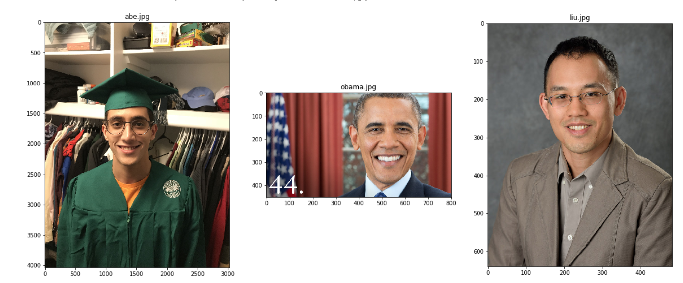
Implementation – Preprocessing images
Anchor Images
Notes:
The “Inception” neural network was used for ImageNet, another neural network image classification algorithm. For the sake of time, I used a pretrained version of this model and optimized it using the Triplet loss function

Slide 11
Implementation – Preprocessing images
Anchor images
Notes:
The “Inception” neural network was used for ImageNet, another neural network image classification algorithm. For the sake of time, I used a pretrained version of this model and optimized it using the Triplet loss function

Slide 12
Implementation – Preprocessing images
Positive images
Notes:
The “Inception” neural network was used for ImageNet, another neural network image classification algorithm. For the sake of time, I used a pretrained version of this model and optimized it using the Triplet loss function

Slide 13
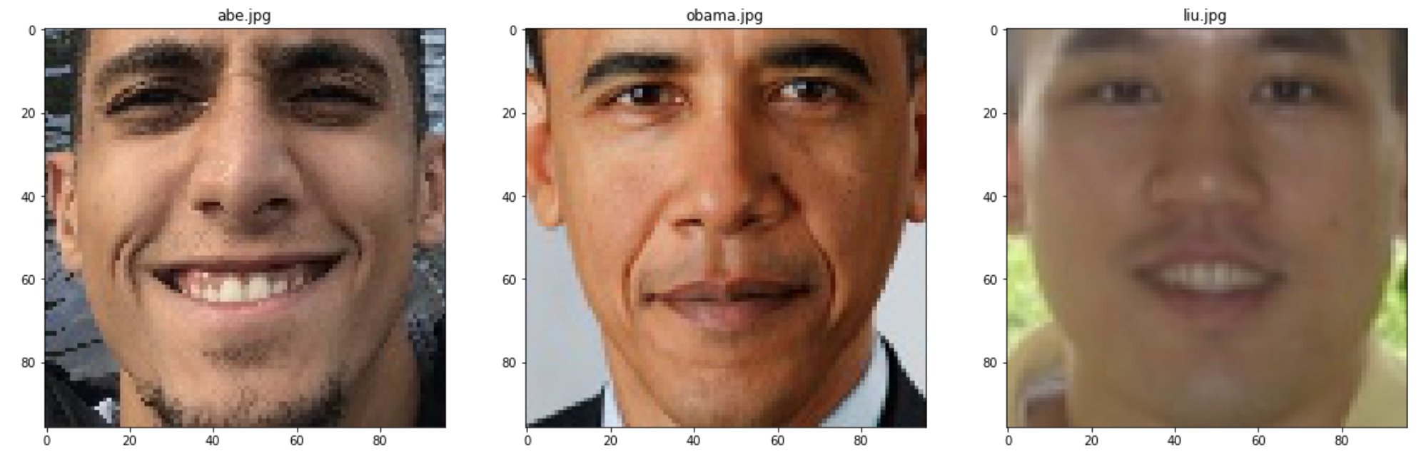
Implementation – Preprocessing images
Positive images
Notes:
The “Inception” neural network was used for ImageNet, another neural network image classification algorithm. For the sake of time, I used a pretrained version of this model and optimized it using the Triplet loss function

Slide 14
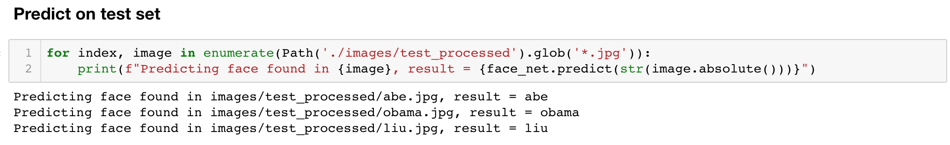
Results – Python Notebook
I laid out the implementation in a python notebook, and the results were pretty good!
Notes:
The TripletLoss function minimizes the distance between

Slide 15
Results – LFW Face Database
I ran some tests on the Labeled Faces in the Wild dataset, here are some results:
96.16%
Negative Pairs Classified Correctly
(out of 2970 sample pairs)
77.74%
Positive Pairs Classified Correctly
(out of 2970 sample pairs)
Notes:
The TripletLoss function minimizes the distance between

Slide 16
References
1. Szegedy, C., et al. "Going deeper with convolutions, CoRR abs/1409.4842." URL http://arxiv. org/abs/1409.4842 (2014).

